Slide 1

PBL Presentation
Predictive Sepsis Detection and Post-Op Health Report Automation
Siddhesh Mawale, Tanmay Kalinkar, Eavam Margamwar
PBL Group No:5
Sem: 5
Under the guidance of
Dr.Pradnya Sulas Borkar
Symbiosis Institute of Technology, Nagpur Campus

Slide 2


INTRODUCTION
What is Sepsis?
Sepsis is a life-threatening condition that arises when the body’s response to infection causes tissue damage, organ failure, or death.
It can be triggered by infections from bacteria, viruses, fungi, or parasites, affecting any part of the body (e.g., lungs, urinary tract, skin, or abdomen).
Symptoms are often nonspecific and may include fever, rapid heart rate, low blood pressure, confusion, and difficulty breathing.
Sepsis is a medical emergency: Every hour of delayed treatment increases the mortality risk by 4–9%.
It is a major global health problem, causing more than 11 million deaths worldwide each year—about 20% of all global deaths.
Early recognition and intervention are crucial for improving patient outcomes and reducing the risk of organ damage or death.

Slide 3
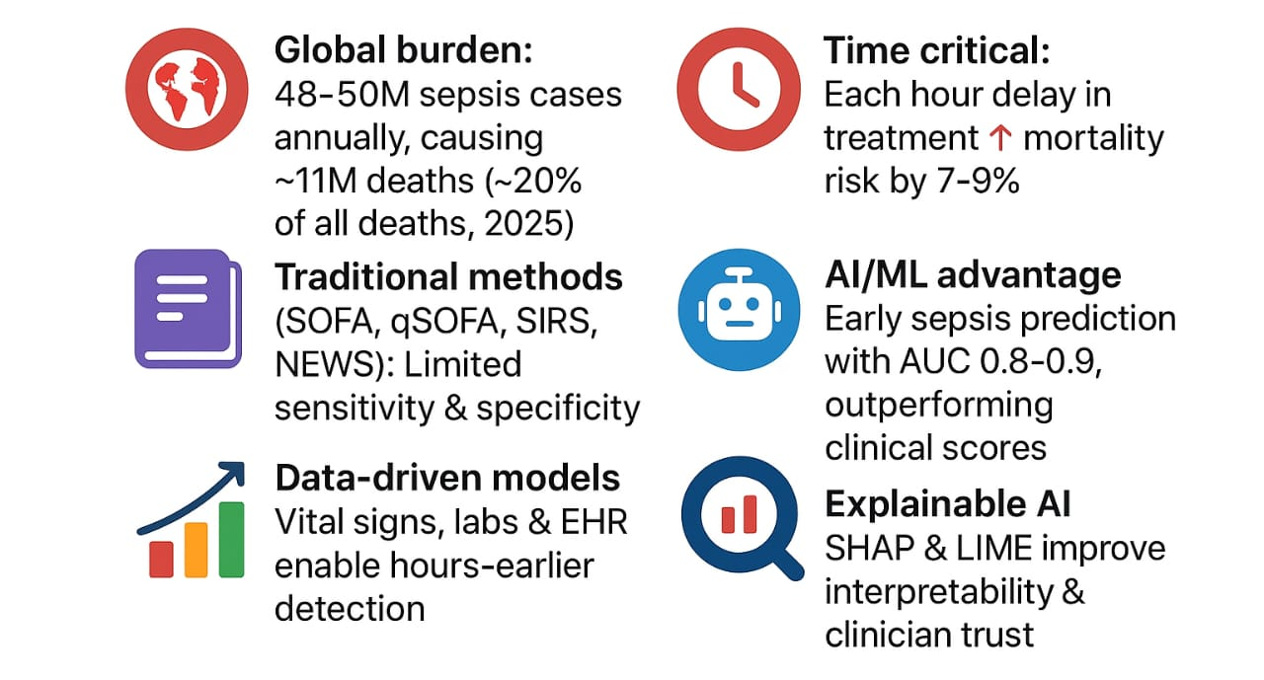
INTRODUCTION

Slide 4
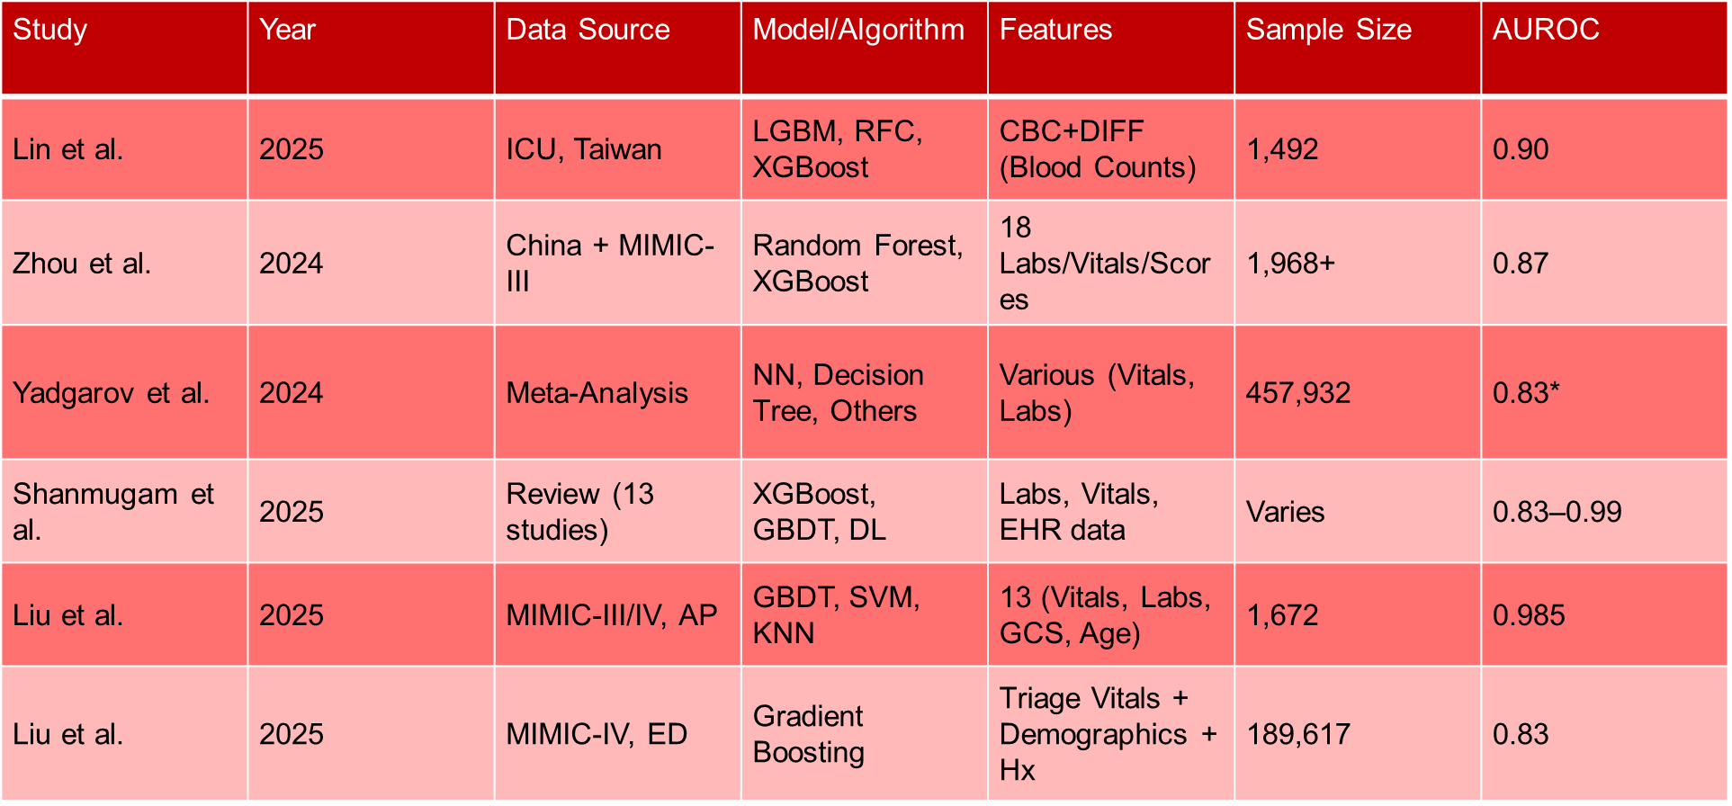
Literature Review

Slide 5
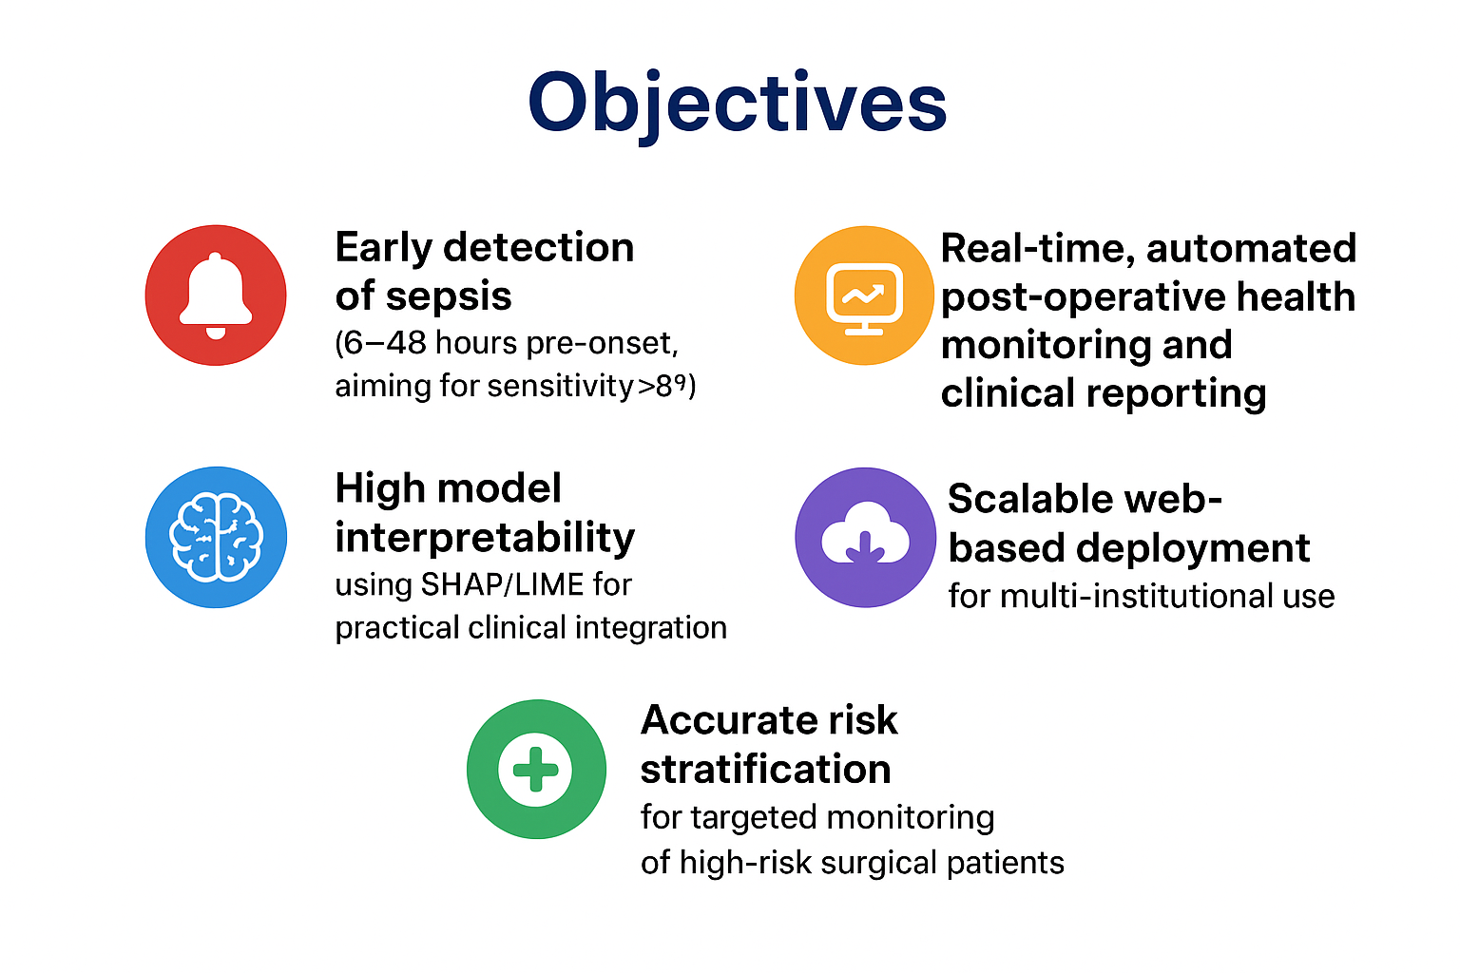
Objective

Slide 6
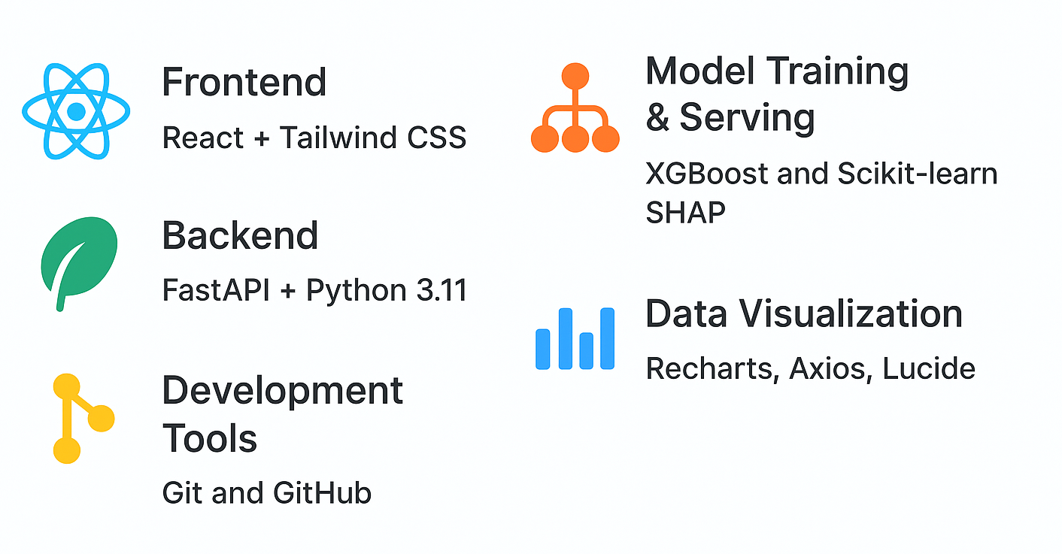
Technology Used
Why This Stack Works Great:
Performance: FastAPI is one of the fastest Python frameworks
Visualization: Recharts excels in clinical data visualization
ML Integration: Perfect setup for serving XGBoost models
Modern UI: React + Tailwind for professional medical interfaces
Explainability: SHAP enables transparent AI decision explanations
Scalability: All components are production-ready and scalable

Slide 7
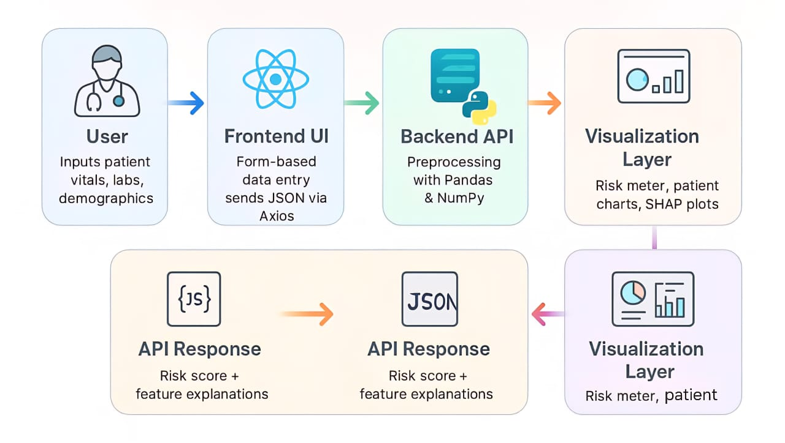
System Architecture

Slide 8
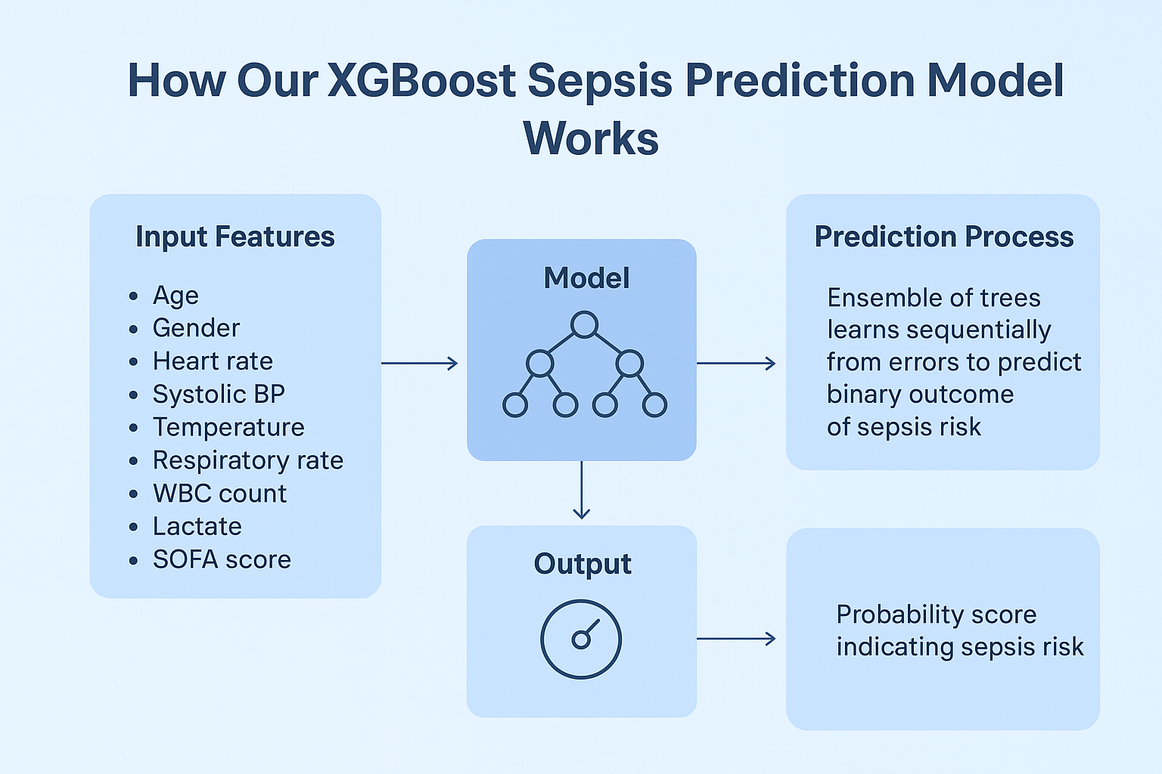
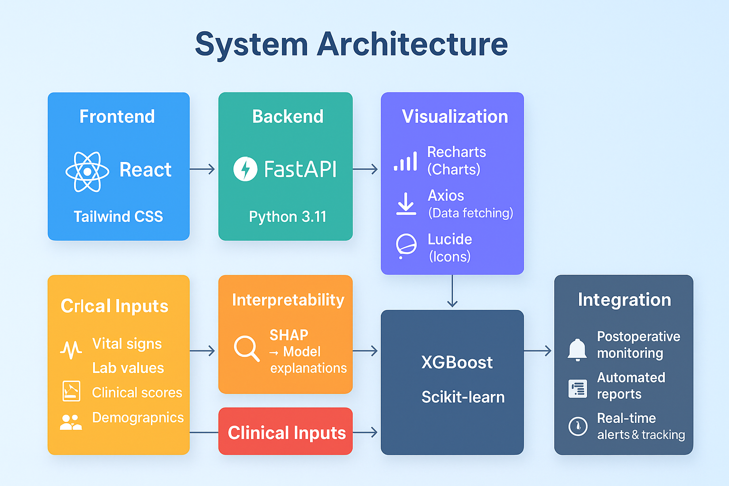
How the model works
XGBoost Sepsis Prediction Model

Slide 9
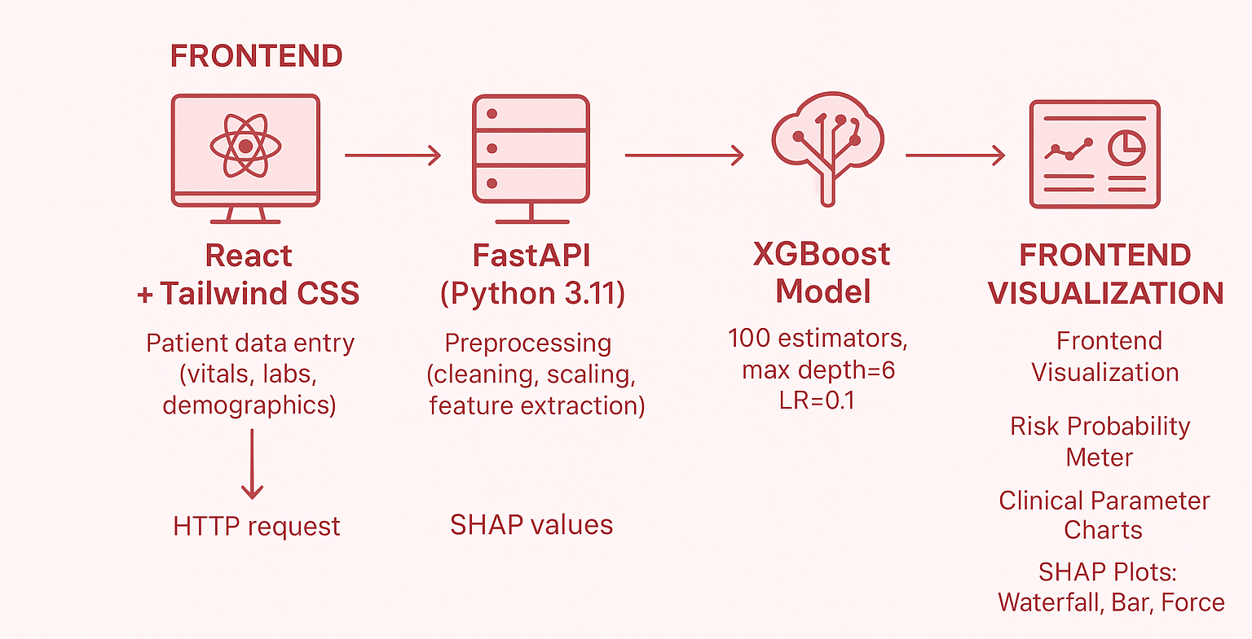
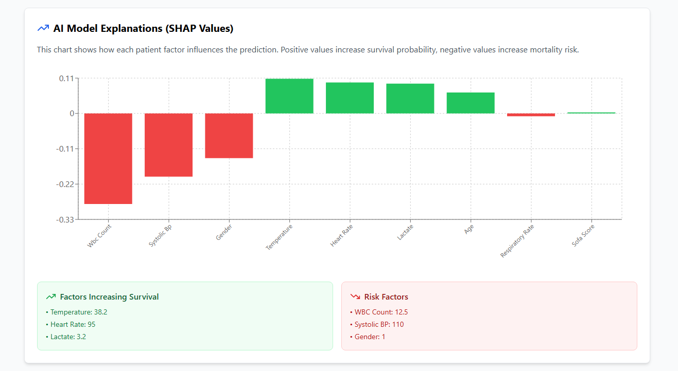
How the model works
Model Integration

Slide 10
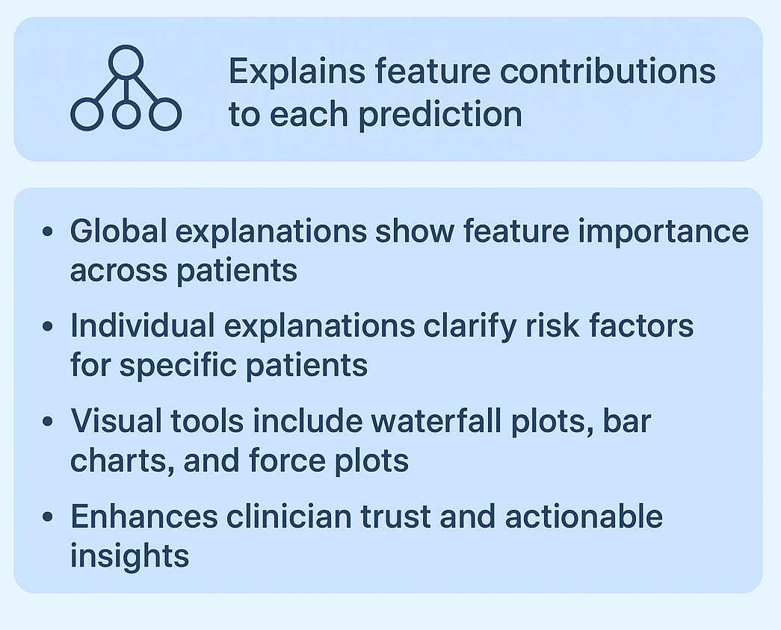
How the model works
Interpretability with SHAP

Slide 11
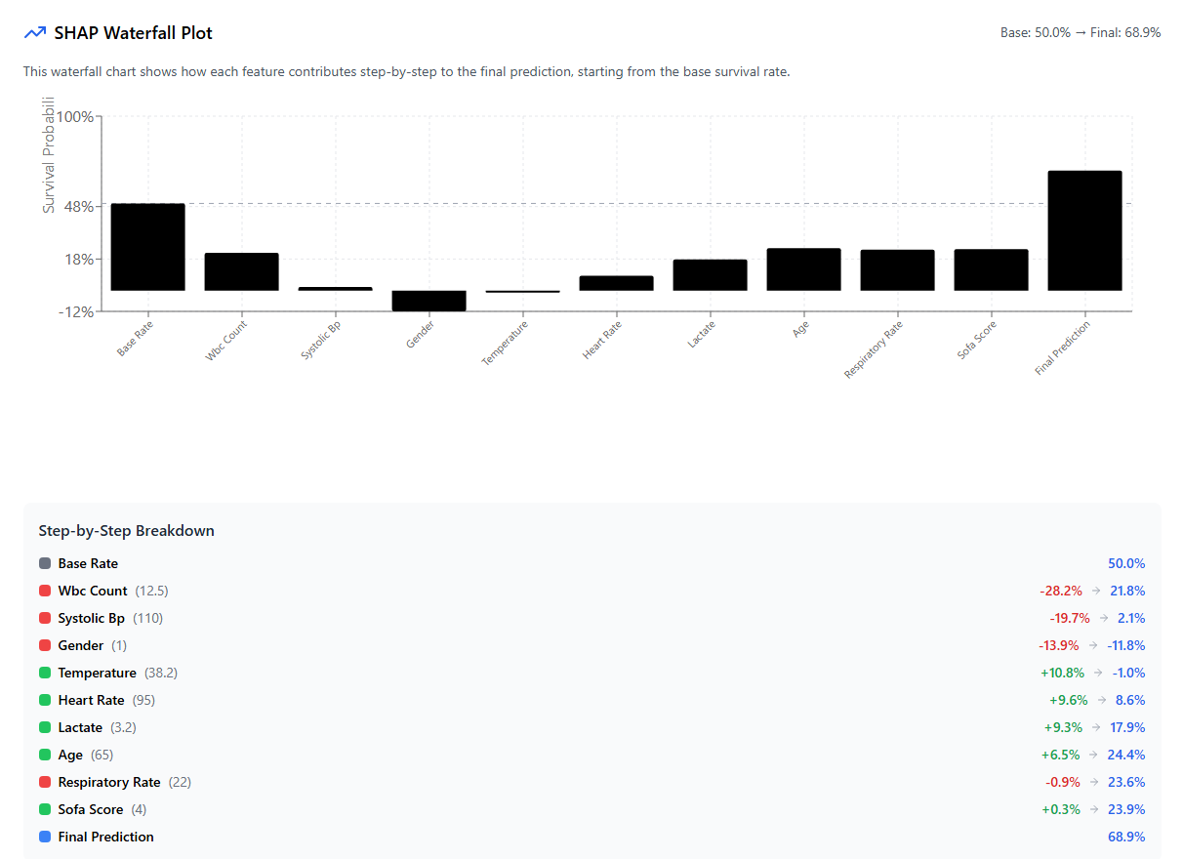
How the model works

Slide 12
Refrences
Lin et al. (2025) - Light Gradient Boosting Machine (LGBM) achieving AUC 0.90 using CBC data Paper: Journal of Medical Internet Research Link to paper
Zhou et al. (2024) - Random Forest model with AUC 0.87 on balanced datasets Paper: Preventive Medicine Reports Link to paper
Various studies using XGBoost with consistent AUCs 0.82-0.91 Example review: Indian Journal of Critical Care Medicine (Shanmugam et al., 2025) Link to paper
Traditional scoring methods: qSOFA and SOFA from multiple clinical validation studies Example: Improving sepsis prediction in intensive care with SepsisAI (2024) Link to paper
Yadgarov et al. (2024) - Comprehensive network meta-analysis of Machine Learning algorithms for sepsis prediction Paper: Frontiers in Medicine Link to paper
Liu et al. (2025) - Gradient Boosting on large scale MIMIC-IV dataset Paper: Scientific Reports Link to paper

Slide 13
Thank You

